Slide 1
CSD 3423
Project Management

Slide 2
CSD 3423 Unit 1
Project Management

Slide 3
Project Management Lesson 1a Learning Outcomes
1. Analyze and discuss the current project management landscape.
1.1 Define what a project is, and contrast how project work compares to day-to-day production work.
1.2 Discuss the role of the project manager, and identify the hard and soft skills required to be effective in the role of project management

Slide 4
1.1 What is a project?
Project – “a temporary endeavor undertaken to create a unique product, service, or result.”
Projects require:
an organized set of work efforts.
progressively elaborated detail.
a defined beginning and ending.
a unique combination of stakeholders.
Projects are subject to time and resource limitations
Notes:
stakeholders – “an individual, or organization who may affect, be affected by, or perceive itself to be affected by a decision, activity, or outcome of a project.” PMBOK® Guide
Another definitions of Project:
The accomplishment of a specific objective by way of using a unique set of interrelated tasks and the effective utilization of resources
A complex, non-routine, one-time effort limited by time, budget, resources, and performance specifications designed to meet customer needs

Slide 5





Examples of Projects:
A young couple hires a firm to design and build them a new house.
A college campus upgrades its technology infrastructure to provide wireless internet access.
A pharmaceutical company launches a new drug.
A government group develops a program to track child immunizations.

Slide 6
Major Characteristics of a Project:
Has a unique purpose/objective and involves doing something never been done before
Is temporary – has a start and an end
Is developed using progressive elaboration or in an iterative fashion
Requires participation and resources, often from various areas across the organizational participation
Has specific time costs, and performance requirements
Should have a primary customer or sponsor
The project sponsor usually provides the direction and funding for the project
Involves Uncertainty
Instructor: Musediq Abdul

Slide 7
Operations VS Projects
Operations | Projects
Routine, Repetitive | Temporary, Unique
Taking Class notes | Writing a term paper
Daily entering sales receipts into ledger | Setting up a sales kiosk for a professional accounting meeting
Responding to a supply-chain request | Developing a supply-chain information system
Practicing scales on the piano | Writing a new piano piece
Routine manufacture of a Blackberry phone | Designing a new Blackberry Passport phone interfaces with android capability & PC
Attaching tags on a manufactured product | Design a wire-tag for Walmart & GE

Slide 8
History of PM
Emerged as a formal discipline in the 1950s
Developed for aerospace and construction
Involved determining project schedules
Manufacturing, R&D, government, and construction refined techniques
Notes:
PM emerged as a formal discipline in the 1950s
Techniques for planning and controlling schedules and costs were developed for huge aerospace and construction projects in the 1950s and 1960s
Early PM involved determining project schedules based on order of project activities
Manufacturing, research and development, government, and construction projects used and refined management techniques
Software companies offered software for planning and controlling project costs and schedules in the 1980s and 1990s
Risk management techniques for complex projects have been applied to less complex projects
Communication and leadership playa major role in project success
Rapid growth and change in information technology and telecommunications fueled use of PM in the 1990s and 2000s

Slide 9
History of PM
Software (1980s and 1990s) for planning and controlling
Risk management techniques
applied to complex projects
Communication and leadership role emerged
Information technology and telecommunications fueled use (1990s and 2000s)
Notes:
Software companies offered software for planning and controlling project costs and schedules in the 1980s and 1990s
Risk management techniques for complex projects have been applied to less complex projects
Communication and leadership play a major role in project success
Rapid growth and change in information technology and telecommunications fueled use of PM in the 1990s and 2000s

Slide 10
What is Project Management (PM)?
Project management – “the application of knowledge, skills, tools and techniques to project activities to meet project requirements.” PMBOK® Guide
Project Phases – these are divisions within a project where extra control is needed to effectively manage the completion of major deliverable

Slide 11
What is Project Management
Intro video – What is project management 2.42 mins
https://www.youtube.com/watch?v=9LSnINglkQA
It is the “application of knowledge, skills, tools and techniques to project activities to meet the project requirements… (and there are) five Process Groups (which are) initiating, planning, executing, monitoring and controlling and closing” (PMBOK, 2013, p. 5) See pg 5-6 for more details
https://www.youtube.com/watch?v=ZLTYzT2ctco&index=5&list=PLnOSatFlECWUgZEDi815_Wt_RyFuxcNol

Slide 12
Who are Project Managers
https://www.youtube.com/watch?v=wNLpxBQnjnM
http://www.pmi.org/about/learn-about-pmi/who-are-project-managers
Most important skills of any Project Manager should be Communications skills because they spend 90% of their time communicating with stakeholders

Slide 13
1.2
Project
Program
Portfolio

Slide 14
Projects and Subprojects
subproject – “a smaller portion of the overall project created when a project is subdivided into more manageable components or pieces.” PMBOK® Guide
A large project may be composed of multiple subprojects
The project manager coordinates subprojects and makes decisions that are best for the overall project

Slide 15
Programs
program – “a group of related projects, subprograms, and
program activities managed in a coordinated way to obtain
benefits not available from managing them individually.”
PMBOK® Guide
Last as long as the organization lasts
Deal with a group of related projects
Projects within a program are of limited duration
Managed at a level above the project manager
Notes:
Project managers should attempt to understand how both portfolio and program decisions impact
their projects and then spend most of their efforts focused on their project.

Slide 16
Portfolio Management
Portfolio management – “aligns with organizational strategies by selecting the right projects, prioritizing work, and providing needed resources.” PMBOK® Guide
Assess organization’s ability to perform projects
Portfolios
Programs
Projects and subprojects

Slide 17
Portfolios
Ongoing operational work
Temporary project work
Seek a balance between
Large and small projects
High-risk, high-reward and low-risk projects
Quick completion and substantial time projects
portfolio – “projects, programs, sub-portfolios, and operations managed as a group to achieve strategic business objectives.” PMBOK® Guide

Slide 18
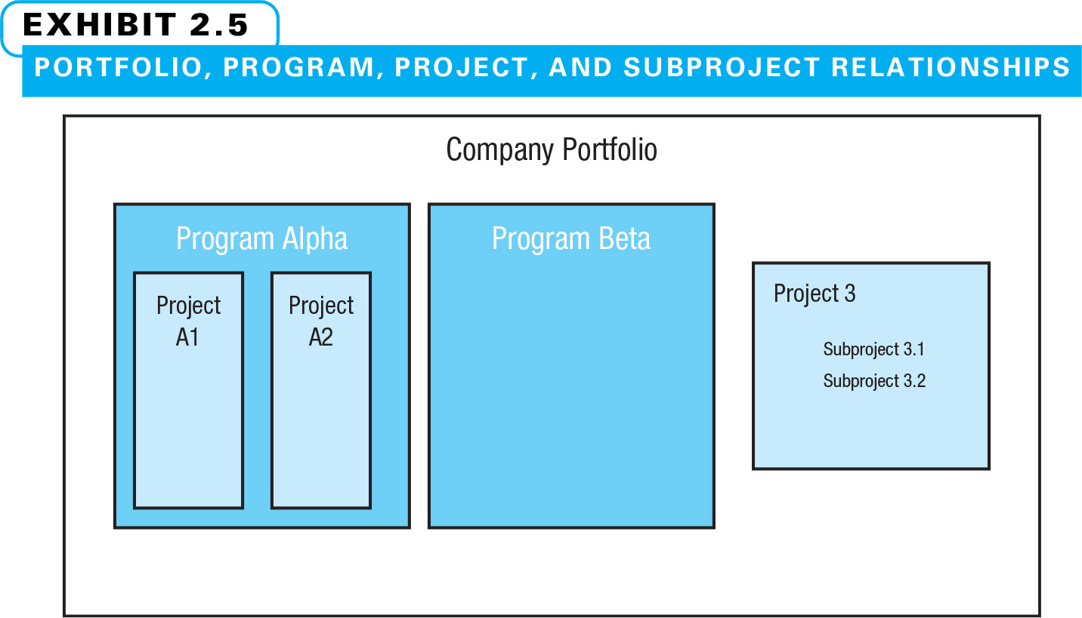
Portfolio, Program, Project, and Subproject Relationships

Slide 19
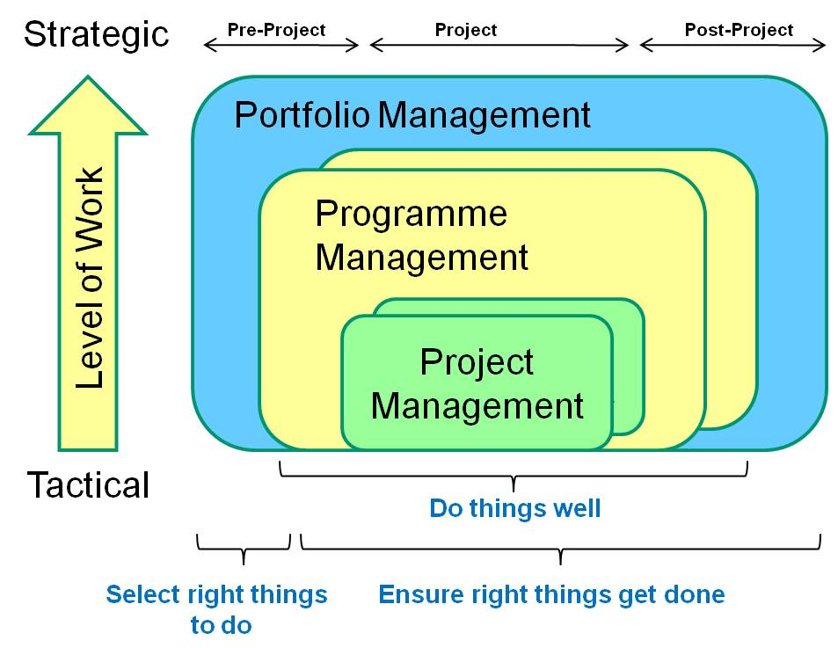

Slide 20
Benefits to Organization
Organizational focus – strategy turned into action
Prioritization – staff knows what is important
Visibility – manager can see where things are
Better resource use – less wasted effort and time
Process improvement – great application of PM
Improved communication – defined approaches/tools
Measurable results – quantifiable objectives
Documentation available – avoids lost knowledge

Slide 21
1.3 Role - Project Manager
The PM is the focal point of the project and leads the planning, executing, and closing of the project
Responsible for the project schedule, although it is created with the project team
Responsible for delivering project results and must do so through the efforts of others

Slide 22
Role - Project Manager cont’d
Manager
Plan the project
Implement the plan
Integrate the systems needed to achieve project objectives
Leader
Manage change
Directing and re-directing the team
Motivating cooperation to achieve objectives
Kotter, John, “What leaders really do”, Harvard Business Review, vol. 68 no. 3 (May-June 1990) , pp. 103-11.
“Management is coping with complexity” … Leadership is coping with change.”

Slide 23
Role - Project Manager cont’d Managing Complexity
Using the process of structured project management to create a framework for action
Identifying the interface conditions of organizational systems and developing plans for integration
Exercise the functions of management

Slide 24
The Role of the PM cont’d Project Manager: Desired Behaviours/Skills
Demonstrates integrity
Effective communicator
People-oriented – facilitating and forceful
Effective integrator
Effective scheduler
Controls project scope
Achieves the right project quality
Identifies and deals with project risks and opportunities
Effectively procures project goods and services
Maintains cost control
What behaviours, skills, attributes would you add to the list?

Slide 25
Essential Skills of Project Managers
People skills
Leadership
Listening
Integrity, ethical behavior, consistent
Strong at building trust
Written & Verbal communication
Strong at building teams
Conflict resolution, conflict management
Critical thinking, problem solving
Understands and balances priorities
Video: https://www.youtube.com/watch?v=AHSjpFUKQR4&spfreload=10

Slide 26
1.3 Source of PM Best Practices
PMI – Project Management Institute
Roles of PMI in the larger context of project management
founded in 1969.
Regulate Professional Certification – PMP, CAPM, PMI-RMP etc.
publishes and regularly updates A Guide to the Project Management Body of Knowledge (PMBOK® Guide).

